Slide 1
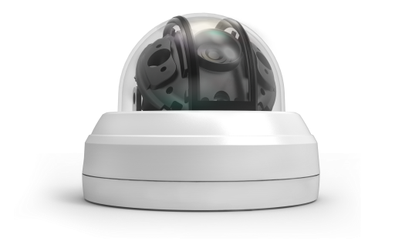
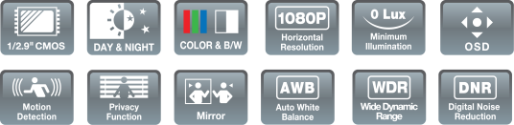
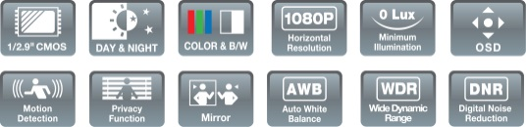

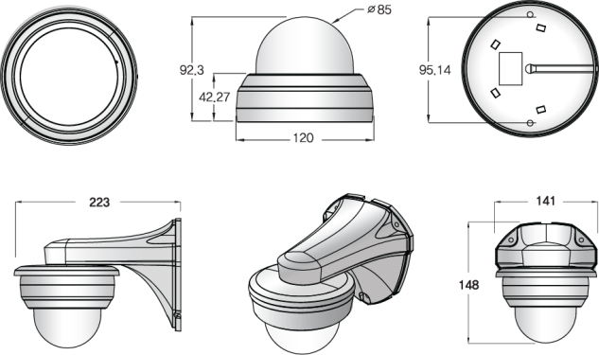
OUTDOOR
DOME
ADVANCED IR BULLET CAMERA
ADVANCED IR LED DOME CAMERA
1/3” Panasonic CMOS(MN34227PL) / High Definition (1080P)
0 Lux at IR On (IR LED 6 pcs) / DNR (Digital Noise Reduction)
WDR (Wide Dynamic Range) / Day & Night (ICR Option) / Easy Installation
ICR V/F lens, DC Auto IRIS V/F Lens, DC Auto IRIS & TDN V/F Lens
(Focal Length : 2.8~12mm) / Fixed lens : 4mm, 6mm
SONY 1/2.8” STARVIS CMOS SENSOR (IMX291)
1920 x 1080 PIXELS
WDR / BLC
DAY ＆ NIGHT
DNR / DEFOG
Image Sensor | Sony 1/2.8" Starvis CMOS Sensor (IMX291)
Total Pixel | 1920 x 1080 Pixels
Scanning system | Progressive
Resolution | Digital: 1080(30P), 720(60P) Max: 1,100TV lines(1080P)
Min. Illumination | 0.0001 lux/F1.2 (sense-up)
Video Output | HD-SDI, EX-SDI, HD-TVI: 1080P 30FPS, 720P 60FPS CVBS: NTSC/PAL
S/N Ratio | More than 50dB (AGC off)
Lens | DC / Manual
AGC | OFF / 0 -10
Shutter Speed | AUTO / MANUAL (1/30 - 1/30,000 sec)
SENS-UP | OFF / X2 - X32
Brightness | 0 - 20
WDR/BLC | OFF / BLC / WDR
D-WDR(ACE) | OFF / LOW / MIDDLE / HIGH
Defog | OFF / LOW / MIDDLE / HIGH
Day&Night | AUTO / COLOR / B&W / EXTERN
White Balance | AUTO / AUTOext / PRESET / Manual
DNR (Digital Noise Reduction) | OFF / LOW / MIDDLE / HIGH
Mirror / Flip | OFF / ON
Sharpness | 0–10 steps
Privacy Mask | 16 Masks
Motion Detection | OFF / ON
Language | English/Chinese/Chinese(S) /Japanese/Korean
Power (Max.) supply | DC12V ~ 48V
Power Input | Connector
Video Output | HD-SDI: MBG/MMCX connector, HD-CVI,HD-TVI,AHD,CVBS
DOME DIMENSIONS (mm)
DOME DIMENSIONS (mm)

