Slide 1
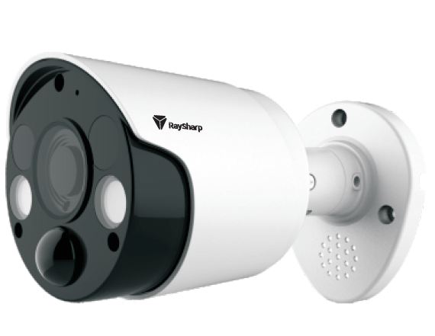
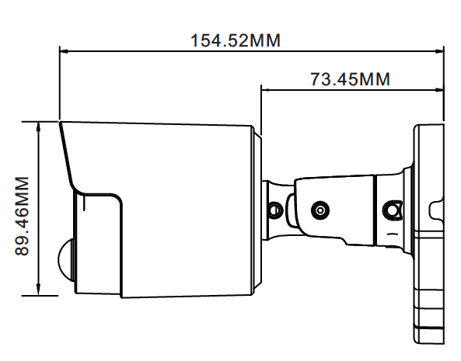
TVI 5MP PIR CAMERA
MODEL IQ-A258FCG-36P
Image Sensor | 5.0MP 1/2.7”
Effective Pixel | 2592 (H) x 1944 (V)
Video Frame Rate | 20fps(NTSC), 20fps (PAL)
Noise Reduction | 2DNR
Lens | 3.6mm Fixed
Video Output | 1channel BNC
Day/Night | IR cut filter with auto switch
IR Range | 10m
Power Supply | DC12V±10%
Power Consumption | Max 4.2W
Working Environment | -10°C~+55°C/ Less than 95%RH

