Slide 1
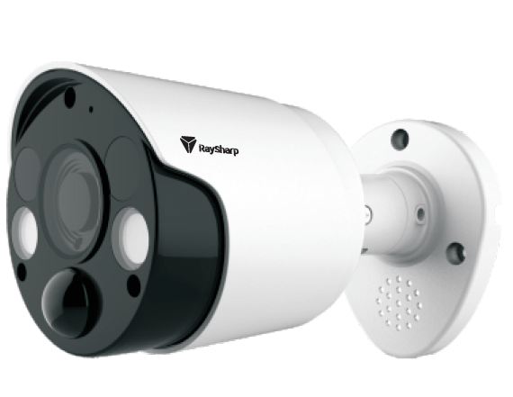
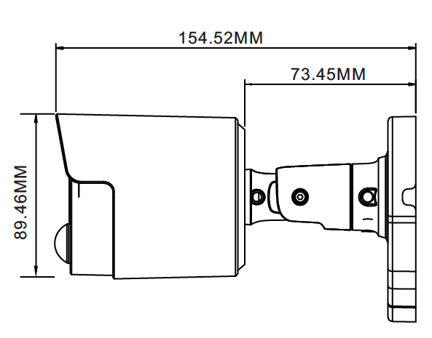
TVI 2MP PIR CAMERA
MODEL IQ-A228NCG-36P
Image Sensor | 2.0MP ½.7”
Effective Pixel | 1920(H) * 1080(V)
Video Frame Rate | 30FPS(NTSC), 25FPS(PAL)
Noise Reduction | 2DNR
Lens | 3.6mm Fixed
Video Output | 1channel BNC
Day/Night | IR cut filter with auto switch
IR Range | 10m
Power Supply | DC12V±10%
Power Consumption | Max 4.2W
Working Environment | -10°C~+55°C/ Less than 95%RH

