Slide 1
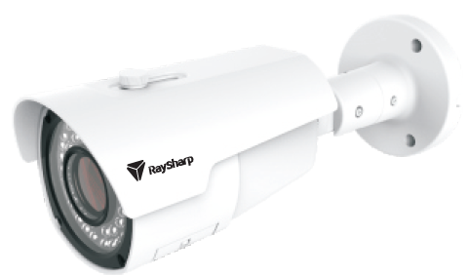
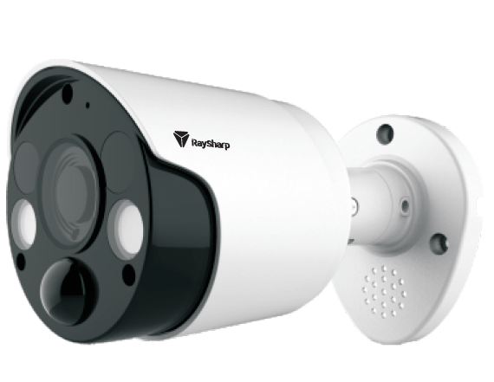
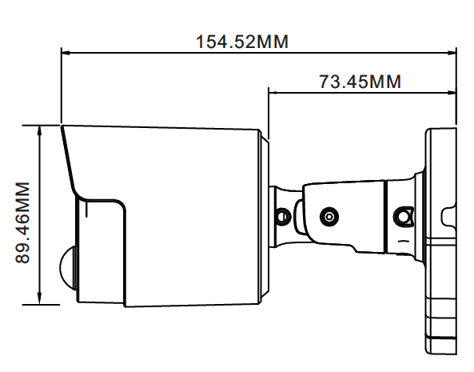
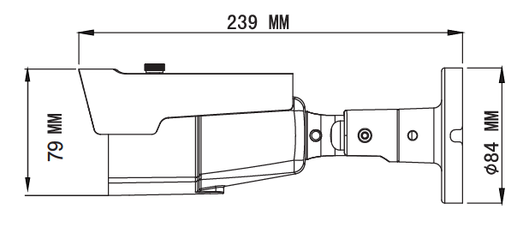
TVI 2MP BULLET CAMERA
TVI 2MP/5MP PIR CAMERA
MODEL IQ-A228NN-36W IQ-A228NA-2812
MODEL IQ-A228NCG-36P IQ-A258FCG-36P
Image Sensor | 2.0MP ½.7”
Effective Pixel | 1920 * 1080
Video Frame Rate | 30FPS(NTSC), 25FPS(PAL)
Noise Reduction | 2DNR
Lens | 3.6mm Fixed | 2.8~12mm Varifocal
Video Output | 1channel BNC
Day/Night | IR cut filter with auto switch
IR Range | 10m | 35m
Power Supply | DC12V±10%
Power Consumption | Max 4.2W
Working Environment | -10°C~+55°C/ Less than 95%RH
Image Sensor | 2.0MP ½.7” | 5.0MP 1/2.7”
Effective Pixel | 1920(H) * 1080(V) | 2592 (H) x 1944 (V)
Video Frame Rate | 30FPS(NTSC), 25FPS(PAL) | 20fps(NTSC), 20fps (PAL)
Noise Reduction | 2DNR
Lens | 3.6mm Fixed | 2.8~12mm Varifocal
Video Output | 1channel BNC
Day/Night | IR cut filter with auto switch
IR Range | 10m | 35m
Power Supply | DC12V±10%
Power Consumption | Max 4.2W
Working Environment | -10°C~+55°C/ Less than 95%RH

Slide 2
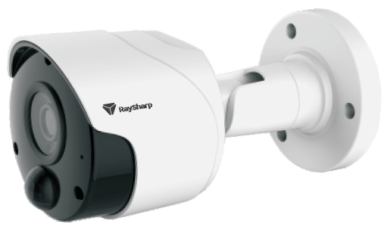
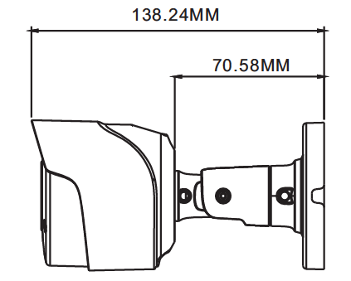
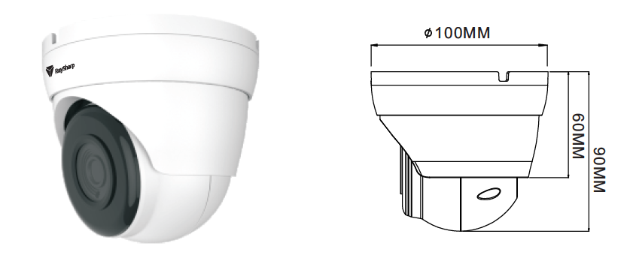
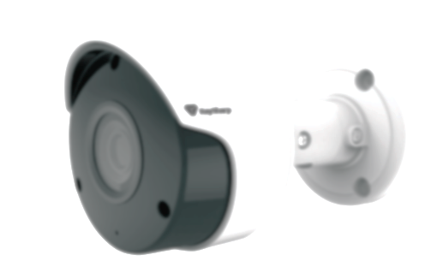
IP 2MP PoE CAMERA
MODEL IQ-CH226MCG-36W IQ-CH326MKE-36W
IR Cut Filter | YES,850nm | YES,850nm
Product Camera Additional Features OSD | support | support
Audio - Microphone(Yes/No) | NO | NO
Audio Range (Mtrs) | 0 | 0
Night Vision(metres) | 20 | 20
IR Cut Filter | support | support
Lens (mm) | 3.6mm | 3.6mm
VariFocal Lens Range (mm) | 3.6mm | 3.6mm
Wide Dynamic Range(Yes/No) | yes | yes
Viewing Angle (degrees) | D:104° H:87.4° V:47° | D:104° H:87.4° V:47°
Backlight Compensation | N/A | N/A
Mechanical Zoom | Fixed-Focus | Fixed-Focus
POE 지원 | 지원함 | 지원함
Operating Tem Range | -20℃ ~40℃ | -20℃ ~40℃
Operating Humid Range | Less than 95% RH(no condensation) | Less than 95% RH(no condensation)
MODEL IQ- CH226MCG-36W IQ-CH326MKE-36W
Camera ChipSet | MSC313E | MSC313E
Image Sensor | 2Megapixel, SC2235, 1/2.7” CMOS | 2Megapixel, SC2235, 1/2.7” CMOS
Video Frame Rate | 2M@20fps | 2M@20fps
Resolution | Mainstream : 1920x1080, 960P, 720P Substream : VGA(640x480), QVGA(320x240) | Mainstream : 1920x1080, 960P, 720P Substream : VGA(640x480), QVGA(320x240)
Aspect Ratio | 16:9 | 16:9
White Balance | AUTO/INDOOE/MANUAL | AUTO/INDOOE/MANUAL
Shuttle Speed | 1/5s - 1/20000s/AUTO | 1/5s - 1/20000s/AUTO
AGC | Off/Low/Mid/High Optional | Off/Low/Mid/High Optional
Noise Reduction | 3DNR | 3DNR
Power Source | DC12V ± 10% | DC12V ± 10%
Power Consumption | 4.2W | 4.2W
IR LED& IR Range | 18pcs & 30m | 18pcs & 30m
Water Proof | IP66 | IP66

Slide 3
IP 2MP/5MP Flood - PIR CAMERA
MODEL IQ- IQ-
Audio
Input / Output (RCA) |  | N/A | N/A
Built-in Microphone |  | Yes | Yes
Dual-way Audio |  | Support | Support
Audio Encode Standard |  | G711A, G711U | G711A, G711U
Sound Detection Alarm |  | Support | Support
Image Control
Flick Control |  | 50Hz / 60Hz | 50Hz / 60Hz
Lens & Angel Flip |  | Support | Support
WDR |  | DWDR | DWDR
Image Settings |  | Back Light, AGC, White Balance, Defog | Back Light, AGC, White Balance, Defog
Color Adjustment |  | Brightness, Contrast, Hue, Saturation, Sharpness | Brightness, Contrast, Hue, Saturation, Sharpness
Privacy Zone |  | Support, max. 4 zones | Support, max. 4 zones
Digital Zoom |  | Support | Support
Record & Playback
SD Card Slot |  | Support on-board storage, up to 128 GB TF card | Support on-board storage, up to 128 GB TF card
Multi Stream Record |  | Either main stream or sub stream | Either main stream or sub stream
Pre-record |  | Support | Support
Network Disconnection Record |  | Support | Support
Record Schedule |  | Continuous, Motion, PIR | Continuous, Motion, PIR
Network
Interface |  | RJ45 10M / 100M Ethernet interface x1 | RJ45 10M / 100M Ethernet interface x1
Protocols |  | TCP/IP, HTTP, HTTPS, DHCP, DNS, DDNS, RTSP, PPPoE, UPnP, SNMP, FTP | TCP/IP, HTTP, HTTPS, DHCP, DNS, DDNS, RTSP, PPPoE, UPnP, SNMP, FTP
I P Filter |  | Allow List or Block List | Allow List or Block List
Alarm Setup
Motion Detection |  | Support | Support
PIR | Detect Agele | Up to 115° | Up to 115°
 | Detect Distance | Up to 32ft/10m | Up to 32ft/10m
Deterence | Floodlight | Support | Support
 | Siren | Support | Support
General
Onvif Version |  | Profile S, Profile G | Profile S, Profile G
General Settings |  | DST, NTP, Time Format, Date Format | DST, NTP, Time Format, Date Format
Power Supply |  | DC 12V / POE | DC 12V / POE
Operating Temperature |  | -30～+55°C | -30～+55°C
MODEL IQ- IQ-
Camera
I mage Sensor |  | 1/2.7" Progressive CMOS | 1/2.7" Progressive CMOS
Min. Illumination |  | Color 0.1lux @ F1.2(AGC ON) ; B/W 0 lux @ IR ON | Color 0.05lux @ F1.2(AGC ON) ; B/W 0 lux @ IR ON
Max. Effective Pixels |  | 1920(H)×1080(V) | 2592(H)×1944(V)
Electronic Shutter Speed |  | Auto, Manual: 1/5 ~ 1/20000s | Auto, Manual: 1/5 ~ 1/20000s
Digital Noise Reduction (DNR) |  | 3D | 3D
IR Cut Control |  | Auto, Color, B/W, Schedule | Auto, Color, B/W, Schedule
IR LEDs |  | 18pcs SMD | 18pcs SMD
IR Distance |  | Up tp 30m (98ft) | Up tp 30m (98ft)
LED Control |  | Auto / Always On / Always Off | Auto / Always On / Always Off
Lens
Lens Type |  | Fixed | Fixed
Focal length |  | Optional 2.8 mm / 3.6mm | Optional 2.8 mm / 3.6mm
Field of View |  | 2.8mm: Horizontal: 103°, Vertical: 58° | 2.8mm: Horizontal: 92°, Vertical: 69°
Video Streaming
Video Compression |  | H.265: Main Profile H.264: Main Profile / High Profile / Baseline | H.265: Main Profile H.264: Main Profile / High Profile / Baseline
Multi Stream |  | Mainstream, Substream | Mainstream, Substream
Frame Rate & Resolution | Main Stream | 1-25fps @ 1920x1080, 1280x960, 1280x720 | 1-15fps @2592×1944, 2592x1520, 2048x1520, 1920x1080, 1280x960, 1280x720
 | Sub Stream | 1-25fps @ 640x480, 320x240 | 1-15fps @ 1280x720, 640x480, 320x240
Bitrate (CBR / VBR) | Main Stream | 256~8192Kbps | 256~8192Kbps
 | Sub Stream | 128~4096Kbps | 128~4096Kbps

