Slide 1
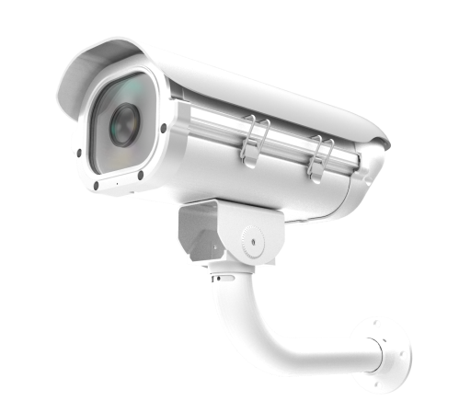
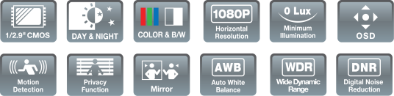
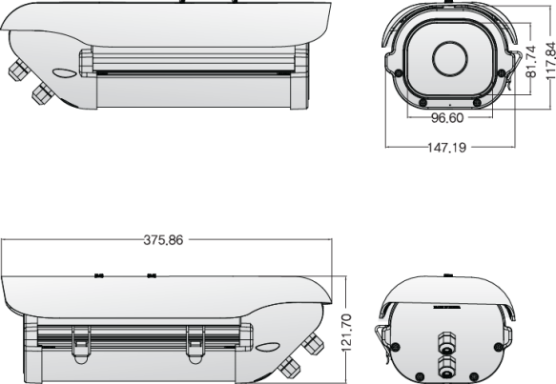
EX-SDI
ADVANCED IR LED OUTDOOR CAMERA
1/2.9 inch SONY CMOS (IMX-222 or IMX-322) / High Definition (1080P)
0 Lux at IR On (IR LED 6 pcs) / DNR (Digital Noise Reduction)
WDR (Wide Dynamic Range) / Day & Night (ICR Option) / Easy Installation
ICR V/F lens, DC Auto IRIS V/F Lens, DC Auto IRIS & TDN V/F Lens
(Focal Length : 6~50mm)
The bracket image
is a reference.
Specification | ISQ-77H6NFC
Resolution | 1080P,720P
Sensor | 1/2.9 inch SONY CMOS (IMX-222 or IMX-322)
Total Pixels | 2000(H) x 1241(V) = 2,482,000
Effective Pixels | 1944(H) X 1092(V) = 2,122,648
Scanning System | PROGRESSIVE
S/N (Y signal) | More than 52 dB (AGC Off)
Video Output | SMPTE292M (EX-SDI, HD-SDI) / (TVI, CVI, CVBS: 1.0Vp-p (75ohm) : Option)
Min.Illumination | 0 Lux at IR On
White Balance | AUTO / AUTO EXT / PRESET / MANUAL
Electronic shutter speed | AUTO / MANUAL (1/30sec ~ 1/30,000sec) / FLICKER
SENS_UP | OFF / X2 ~ X32
DNR / ACE | OFF / LOW / MIDDLE / HIGH
BACKLIGHT | OFF / WDR / BLC / HLC
Day & Night | AUTO (Day <--> Night TIME Change) , COLOR , B/W, EXTERN
PRIVACY / FLIP / FREEZE | OFF / ON
MOTION / DEFOG | OFF / SET
Language | ENG, CHN, CHN(S), JPN, KOR
Sharpness / Smart IR / Brightness | ADJUSTABLE (Sharpness : 0 ~ 10 STEP / Smart IR, Brightness : 0 ~ 20 STEP )
COMM. | RS-485(PELCO-D)
Operating Temperature/Humidity | -10'C~+50'C / 30%~80% RH
Storage Temperature/Humidity | -20'C~+60'C / 20%~90% RH
Power | DC12V [ AC24V / DC12V DualPower (option) ]
signal Transmission | The distant difference is occurred according to cable option and other circumstances. (based on 5C-HFBT : HD-SDI 200M / EX-SDI 500M)
DOME DIMENSIONS (mm)

