Slide 1
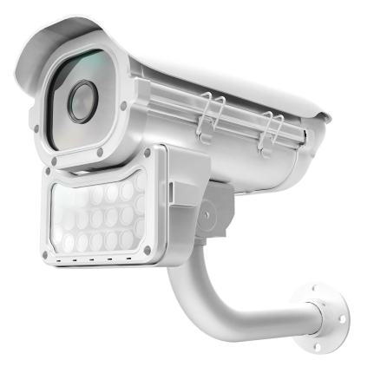

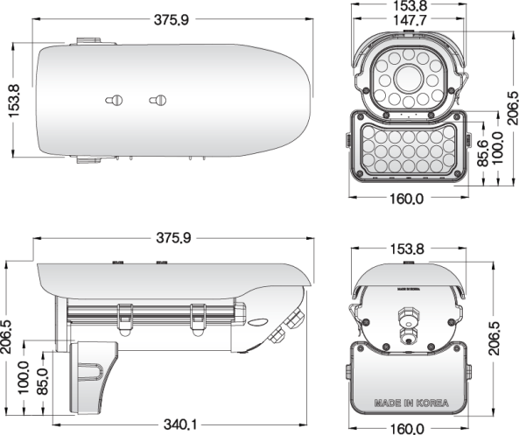
EX-SDI 2.0
ADVANCED IR LED OUTDOOR CAMERA
1/2.8 inch SONY CMOS (IMX-291)
0 Lux at IR On (IR LED 12 pcs) / Upgraded Waterproof Housing (IP 68 rating)
DNR (Digital Noise Reduction) / WDR (Wide Dynamic Range)
Day & Night (ICR Option) / Easy Installation
ICR V/F lens, DC Auto IRIS V/F Lens, DC Auto IRIS & TDN V/F Lens
(Focal Length : 2.8~12mm, 3.5~16mm) / Fixed Lens 4.3mm, 6mm
Specification | S77 (EX-SDI) . HPOD S77H33V . HPOD S77H33
Resolution | 1080P, 720P,
Sensor | 1/2.8 inch SONY CMOS (IMX-291)
Total Pixels | 1945(H) x 1109(V) = 2.16M
Effective Pixels | 1945(H) X 1097(V) = 2.13M
Scanning System | PROGRESSIVE
S/N (Y signal) | More than 52 dB (AGC Off)
Video Output | SMPTE292M (EX-SDI, HD-SDI) / (TVI, CVI, CVBS: 1.0Vp-p (75ohm) : Option)
Min.Illumination | 0 Lux at IR On
White Balance | AUTO / AUTO EXT / PRESET / MANUAL
Electronic shutter speed | AUTO / MANUAL (1/30sec ~ 1/30,000sec) / FLICKER
SENS_UP | OFF / X2 ~ x32
DNR / ACE | OFF / LOW / MIDDLE / HIGH
BACKLIGHT | OFF / WDR / BLC / HLC
Day & Night | AUTO (Day <--> Night TIME Change) , COLOR , B/W, EXTERN
PRIVACY / FLIP / MOTION / DEFOG | OFF / ON
Language | ENG, CHN, CHN(S), JPN, KOR
Sharpness / Smart IR / Brightness | ADJUSTABLE (Sharpness : 0 ~ 10 STEP / Smart IR, Brightness : 0 ~ 20 STEP )
COMM. | RS-485(PELCO-D)
Temperature/Humidity | Operating (-10'C~+50'C / 30%~80% RH) / Storage (-20'C~+60'C / 20%~90% RH)
Power | DC12V [ AC24V / DC12V DualPower (option) ]
signal Transmission | The distant difference is occurred according to cable option and other circumstances. (based on 5C-HFBT : HD-SDI (200M) / EX-SDI (500M))
BULLET DIMENSIONS (mm)

