Slide 1
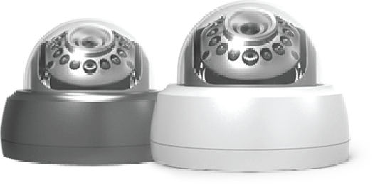

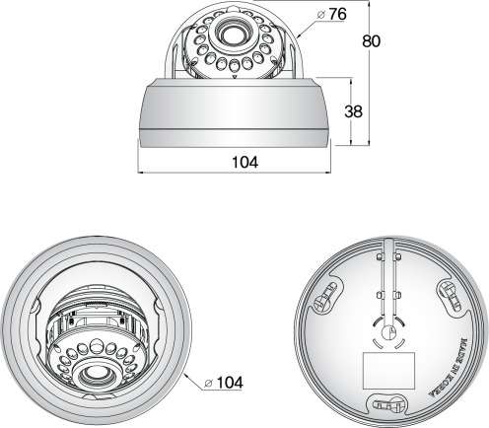
EX-SDI 2.0
ADVANCED IR LED DOME CAMERA
1/2.8 inch SONY CMOS (IMX-291) / 0 Lux at IR On (IR LED 15 pcs)
DNR (Digital Noise Reduction) / Day & Night (ICR Option) / Easy Installation
Fixed Lens 4.3mm, 6mm
Specification | S77 (EX-SDI) . HID5 S7715
Resolution | 1080P, 720P,
Sensor | 1/2.8 inch SONY CMOS (IMX-291)
Total Pixels | 1945(H) x 1109(V) = 2.16M
Effective Pixels | 1945(H) X 1097(V) = 2.13M
Scanning System | PROGRESSIVE
S/N (Y signal) | More than 52 dB (AGC Off)
Video Output | SMPTE292M (EX-SDI, HD-SDI) / (TVI, CVI, CVBS: 1.0Vp-p (75ohm) : Option)
Min.Illumination | 0 Lux at IR On
White Balance | AUTO
Electronic shutter speed | AUTO
DNR | ON
Day & Night | EXTERN,
Temperature/Humidity | Operating (-10'C~+50'C / 30%~80% RH) / Storage (-20'C~+60'C / 20%~90% RH)
Power | Only DC12V
signal Transmission | The distant difference is occurred according to cable option and other circumstances. (based on 5C-HFBT : HD-SDI (200M) / EX-SDI (500M))
DOME DIMENSIONS (mm)

