Slide 1
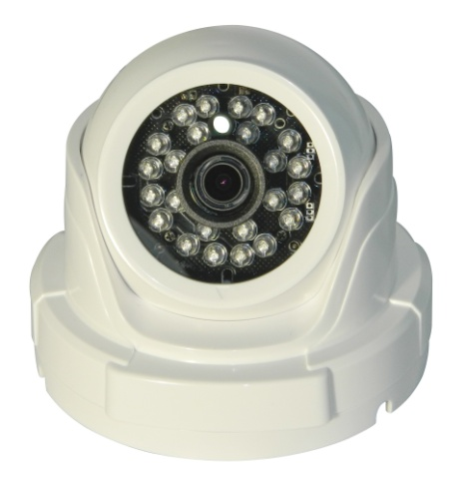
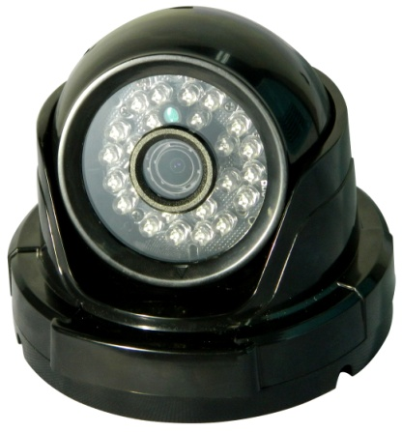

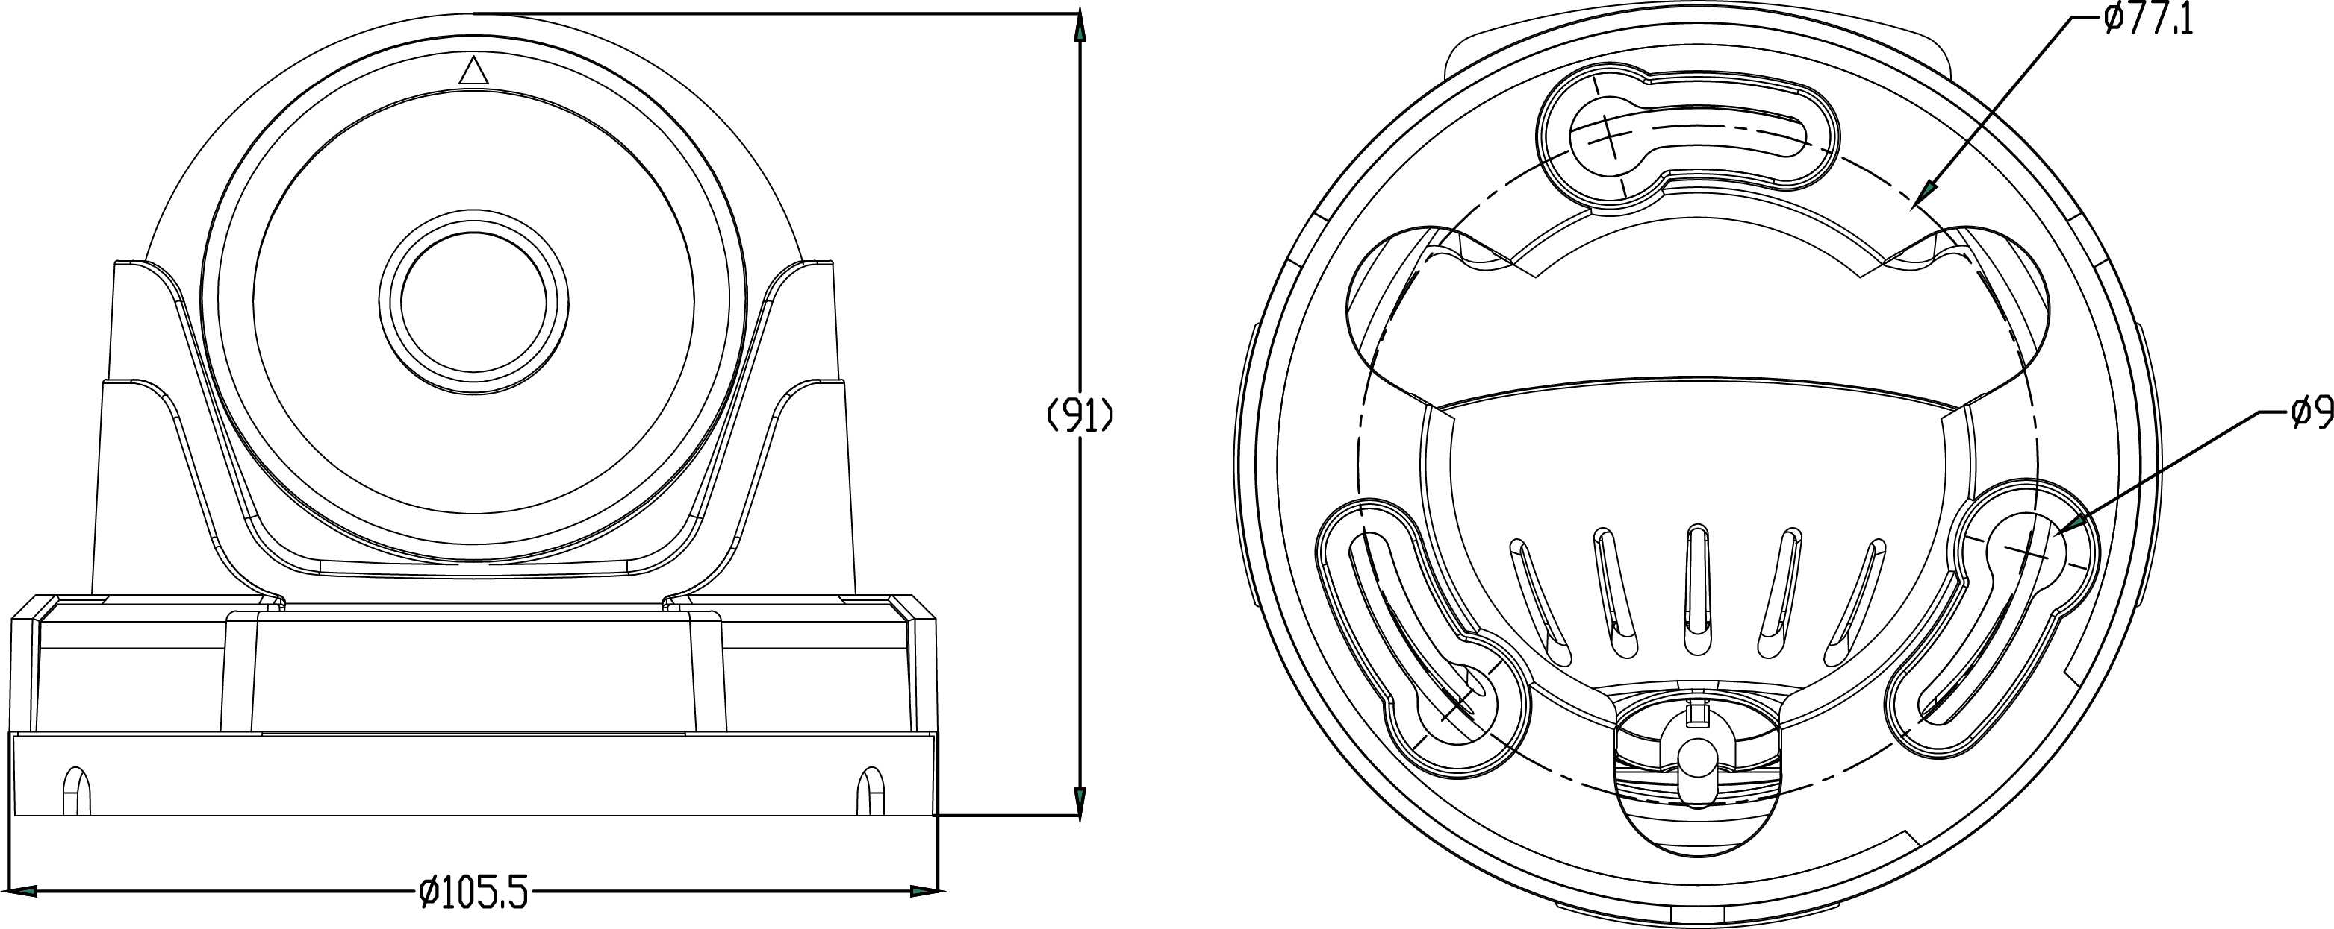
AHD
INFRARED DOME CAMERA
1/2.9 inch SONY CMOS
High Resolution / 0 Lux at IR On (IR LED 24 pcs)
Day & Night(ICR mechanism) / DNR (Digital Noise Reduction) / Easy Installation
Fixed Lens 2.8mm ,3.7mm, 6mm
Specification | ISQ-I24FA (WHITE, BLACK)
Resolution | 1080P[ FULL HD]
Sensor | 1/2.9 inch SONY CMOS
Total Pixels | 2001(H) X 1121(V) approx. 2.24 M pixels
Effective Pixels | 1985(H) X 1105(V) Approx. 2.19M pixels
Scanning System | Progressive
S/N (Y signal) | More than 42 dB (AGC Off)
Video Output | AHD : 2.0 (1080P)
Min.Illumination | 0 Lux at IR On
White Balance | ATW
Electronic shutter speed | Auto
UTC | Support
DNR (2D, 3D) | ON
Day & Night | True Day & Night with ICR Mechanism
Temperature/Humidity | Operating (-10'C~+50'C / 30%~80% RH) / Storage (-20'C~+60'C / 20%~90% RH)
Power | Only DC12V
DIMENSIONS (mm)

