Slide 1
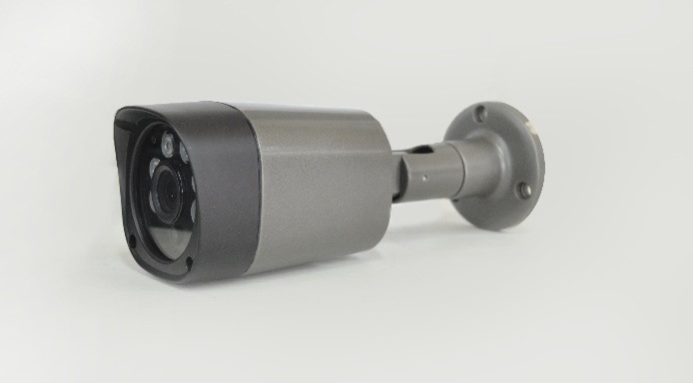

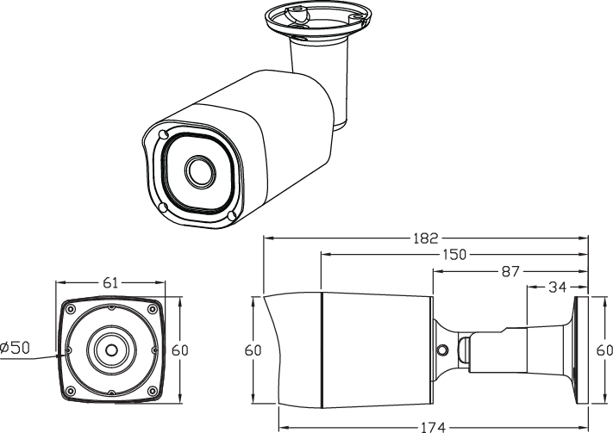
AHD
INFRARE BULLET CAMERA
1/2.9 inch SONY CMOS
High Resolution / 0 Lux at IR On (IR LED 35 pcs)
Day & Night (ICR OPTION) / DNR (Digital Noise Reduction) / Easy Installation
Fixed Lens 3.6mm, 3.7mm, 4mm, 4.3mm
Specification | 85 (AHD) . ISQ-HIC685H6
Resolution | 1080P
Sensor | 1/2.9 inch SONY CMOS
Total Pixels | 2000 (H) x 1241 (V) = 2.48M
Effective Pixels | 1984 (H) x 1225 (V) = 2.43M
Scanning System | PROGRESSIVE
S/N (Y signal) | More than 52 dB (AGC Off)
Video Output | AHD : 2.0 (1080P) / CVBS: 1.0Vp-p (75ohm)
Min.Illumination | 0 Lux at IR On
White Balance | ATW
Electronic shutter speed | AUTO
DNR (2D, 3D) | ON
Day & Night | AUTO (Day <--> Night TIME Change)
Temperature/Humidity | Operating (-10'C~+50'C / 30%~80% RH) / Storage (-20'C~+60'C / 20%~90% RH)
Power | Only DC12V
BULLET DIMENSIONS (mm)

