Slide 1
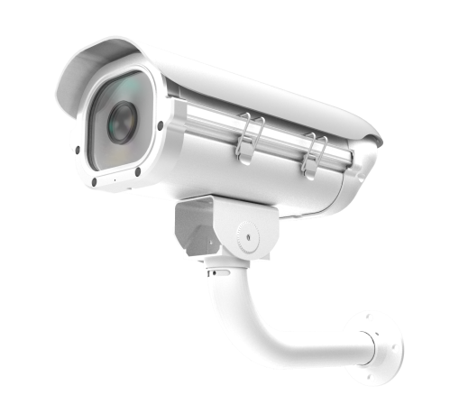
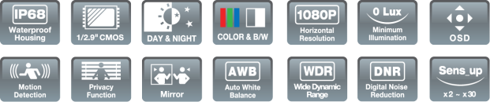
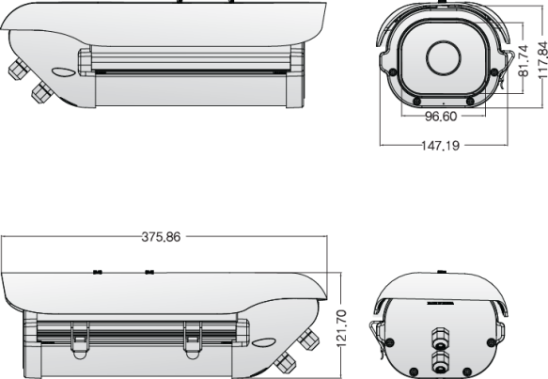
AHD
ADVANCED IR LED OUTDOOR CAMERA
1/2.9 inch SONY CMOS / High Resolution (Sens up x 30)
0 Lux at IR On (IR LED 04 pcs) / D-WDR (Digital Wide Dynamic Range)
Day & Night (ICR OPTION) / DNR (Digital Noise Reduction) / Easy Installation
Fixed Lens : 4mm / 6mm
The bracket image
is a reference.
Specification | 85 (AHD) . ISQ-85H6NT
Resolution | 1080P
Sensor | 1/2.9 inch SONY CMOS
Total Pixels | 2000 (H) x 1241 (V) = 2.48M
Effective Pixels | 1984 (H) x 1225 (V) = 2.43M
Scanning System | PROGRESSIVE
S/N (Y signal) | More than 52 dB (AGC Off)
Video Output | AHD : 2.0 (1080P) / CVBS: 1.0Vp-p (75ohm)
Min.Illumination | 0 Lux at IR On
White Balance | ATW / AWB / AWC → SET / INDOOR / OUTDOOR / MANUAL
Electronic shutter speed | AUTO / MANUAL (1/30sec ~ 1/50,000sec) / FLICKER
SENS_UP | OFF / X2 / X4 / X6 / x8 / x10 / x15 / x20 / x25 / x30
DNR (2D, 3D) | OFF / LOW / MIDDLE / HIGH
BLC | OFF / LOW / MIDDLE / HIGH
Day & Night | AUTO (Day <--> Night TIME Change) , COLOR , B/W, EXTERN
D-WDR / PRIVACY / FLIP / FREEZE | OFF / ON
MOTION / DEFOG | OFF / SET
Brightness | ADJUSTABLE (0 ~ 100 STEP)
Sharpness | ADJUSTABLE (0 ~ 10 STEP)
Smart IR | ADJUSTABLE (0 ~ 15 STEP)
Language | ENG, CHN1, CHN2, GER, FRA, ITA, SPA, POL, RUS, POR, NED, TUR
Temperature/Humidity | Operating (-10'C~+50'C / 30%~80% RH) / Storage (-20'C~+60'C / 20%~90% RH)
Power | DC12V [ AC24V / DC12V DualPower (option) ]
DOME DIMENSIONS (mm)

