Slide 1
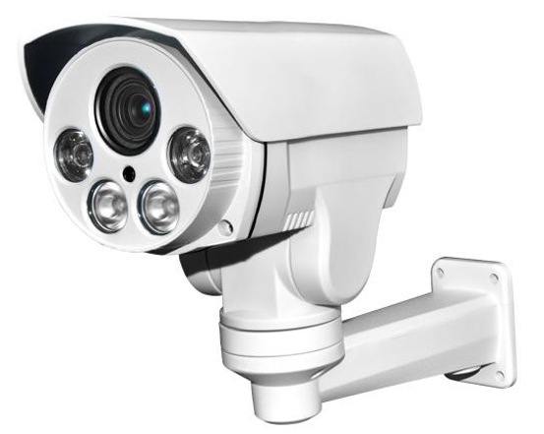

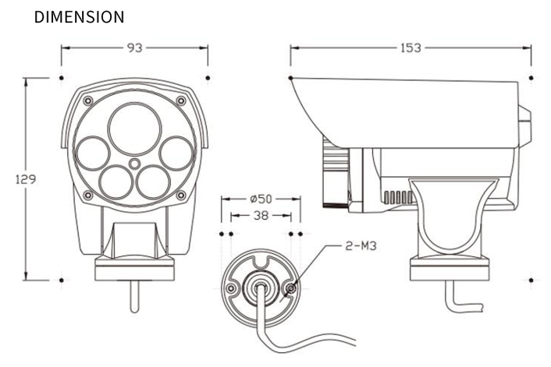
MINI PTZ CAMERA
ADVANCED IR LED PTZ CAMERA
1/2.8 inch SONY CMOS (IMX-291)
0 Lux at IR On (IR LED 04 pcs) / Upgraded Waterproof Housing (IP 66 rating)
DNR (Digital Noise Reduction) / Day & Night / Easy Installation
Fixed Lens 2.8~12mm / 5~50mm
Specification | IQ-BH4PT
Resolution | TVI , 1080P,
Sensor | 1/2.8 inch SONY CMOS (IMX-291)
Total Pixels | 2001(H) x 1121(V) = 2.24M
Effective Pixels | 1945(H) X 1097(V) = 2.13M
Scanning System | PROGRESSIVE
S/N (Y signal) | More than 42 dB (AGC Off)
Video Output | TVI : 1.0Vp-p (75ohm)
Min.Illumination | 0 Lux at IR On
White Balance | AUTO
Electronic shutter speed | AUTO
DNR | ON (3D&2D-DNR)
Day & Night | True Day & Night with ICR Mechanism
Temperature/Humidity | Operating (-10'C~+50'C / 30%~80% RH) / Storage (-20'C~+50'C / 20%~90% RH)
Power | Only DC12V 2W(160mA) / 15W (Max. 1500mA0
Rotation Speed & pan/tilt | 15°/ s PAN : 0~350° / TILT : -5~60°
BULLET DIMENSIONS (mm)

