Slide 1
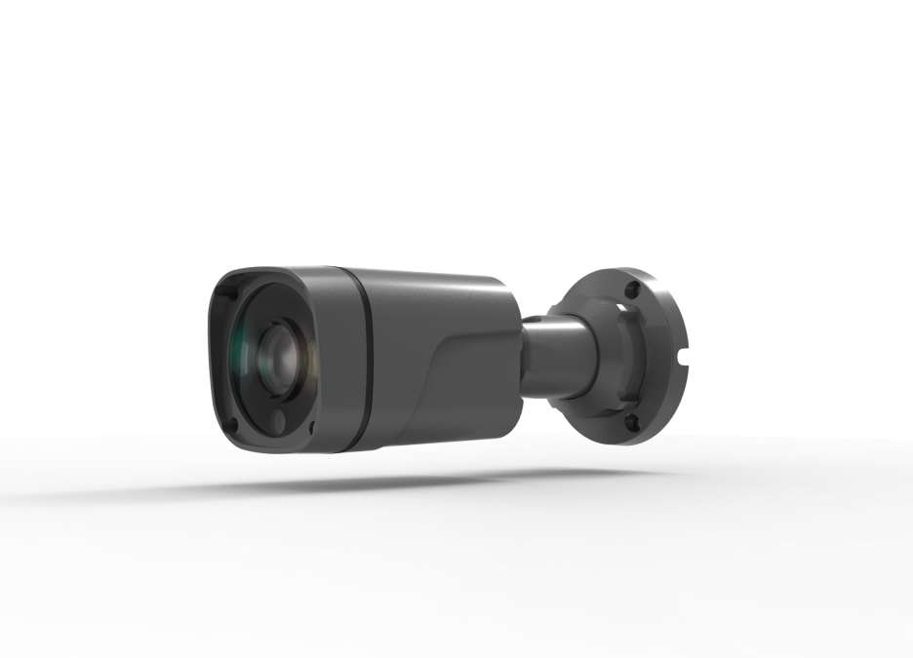


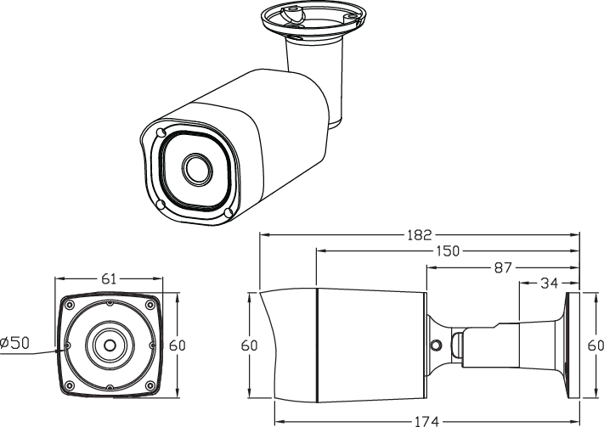
HBI62 VPX2H2T-40
ADVANCED IR LED BULLET CAMERA
1/2.8" CMOS sensor(SONY IMX290)
0 Lux at IR On (IR LED 04 pcs) / Upgraded Waterproof Housing (IP 68 rating)
DNR (Digital Noise Reduction) / WDR (Wide Dynamic Range)
Day & Night (ICR Option) / Easy Installation
Fixed 4mm
System Structure | DSP | Embedded RTOS, DSP(Hi3516C V300)
 | Sensor | 1/2.8" CMOS sensor(SONY IMX290)
Video Encoding | Video Encoding | H.265/ H.264High Profile/Main Profile/Base Line Profile/ MJPEG
 |  | H.265+/H.264High Profile+/Main Profile+/Base LineProfile+
 | Maximum Image Output | Main stream：1920*1080@25/30fps ; Auxiliary stream 1: 704*576@25/30fps；Auxiliary stream 2: 1280*720@25/30fps ；
 | Streaming transmission | Three stream
 | Video Bite rate | 32Kbps~8MKbps
Image Enhancement | Min. illumination | Color0.01Lux@F1.2（AGC ON）； Black and white0.001Lux@F1.2（AGC ON）
 | Electronic shutter | Auto（1/25 to 1/10000）
 | Day/Night switch | Color/B&W/Light sensitive switch/Mixed mode switch
 | DNR | 2D and 3D DNR
 | WDR | Support true WDR
 | Video Adjust | Sharpness, Brightness, Saturation, Contrast, chroma adjustable
 | Image model | Transparent /real
 | Color pattern | Standard /gorgeous
 | Corridor pattern / Backlight- compensation / Unti-fog | Support
Interfaces | Signal interface | One photosensitive resistance signal interface, one IR_CUT drive interface support photo resistance signal links to IR-CUT and IR light
 | Smart IR / Reset interface / CVBS interface / USB interface / Network light interface | One Port
 | Audio interface | One audio in；One audio out
 | Alarm interface | One alarm in
 | Power interface | One DC12V power input
 | POE interface | One Extended Interface
 | Network interface | One RJ45 10/100M Port
Functions | Motion detection | Multiple detection zones, variable sensitivity levels
 | Capture function | JPEG，capture resolution is the max coding resolution
 | Security | Password protection and water marker
 | OSD | Support Channel Name and Time，custom character superposition，image overlay
 | Smart function | Perimeter Intrusion Detection
 | Smart alarm | Network abnormal, cover alarm etc.
 | Storage | Support FTP storage
 | Smart function | Perimeter Intrusion Detection
 | Protocol support | TCP/IP；UDP；HTTP；IGMP ；ICMP；DHCP；RTP/RTSP；DNS；DDNS；FTP； NTP；PPPOE；UPNP；SMTP；SNMP
 | Interface protocol | ONVIF/CGI
General | Power Supply | DC12V/POE(-P)
 | Power Consumption | <1W (without infrared lamp board)
 | Lightning Protection | Power , network, POE all lightning protection, meets with standard GB/T17626.5，and IEC61000-4-5
DOME DIMENSIONS (mm)

